Slide 1
An Extensible Framework for Creating Personal Web Archives of Content Behind Authentication
Mat Kelly
Director: | Michele C. Weigle
Committee: | Michael L. Nelson
 | Yaohang Li

Slide 2

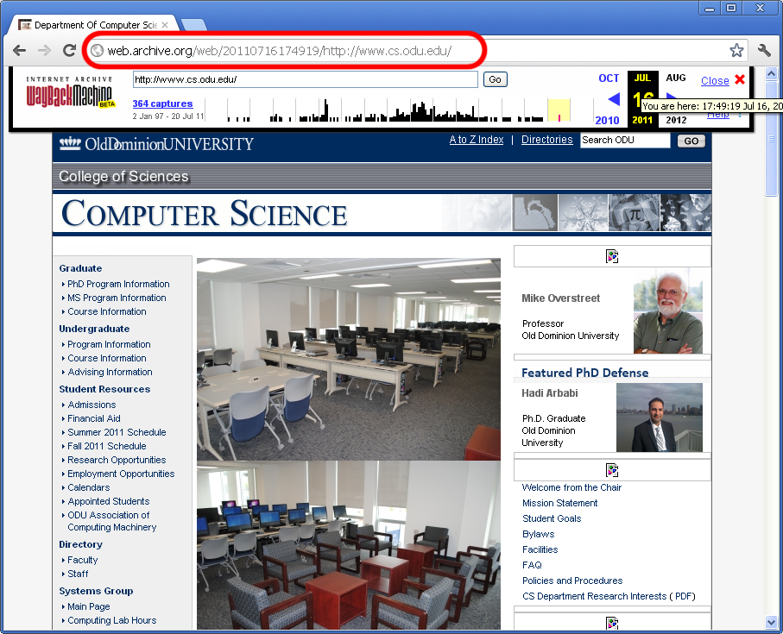

Background
Internet Archive crawls and preserves webpages creating web archives
Only public sites are preserved
Notes:
Maintaining record of web is preserving digital heritage
Internet Archive crawls and preserves webpages creating web archives
Preserved pages replayable at archive.org
Only publicly accessible sites preserved

Slide 3
Problems
A lot of content on web is not preserved
e.g., Social media content
As more people document lives on social media, importance of preserving becomes greater
Content not preserved = heritage lost

Slide 4
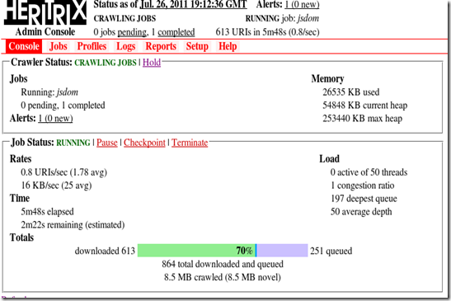
Problems: Unsuitability of Institutional Tools
Overhead and learning curve is steep
Institutional tools meant for larger scale
Notes:
Works well if you expend the energy to learn

Slide 5

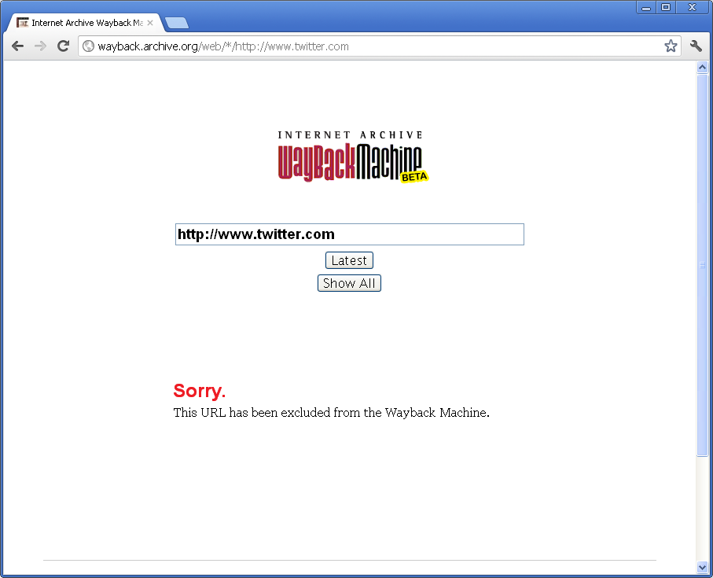
Problems: Complete Lack of Preservation

Slide 6
State of the Art in Personal Web Archiving
Personal web archiving tools
Break when target sites’ hierarchy changes
Produce sub-optimal archives
Some conventional web archiving practices not easily translatable to personal web archiving

Slide 7
Goals of Thesis
Show social media content can be preserved
With output more optimal than current offerings
Remedy the tools’ breaking problem
Remotely specify target sites’ hierarchies
Show spec is easily adaptable to tools
Identify and consider solutions to domain-specific nuances
Establish section commonality between social media websites

Slide 8
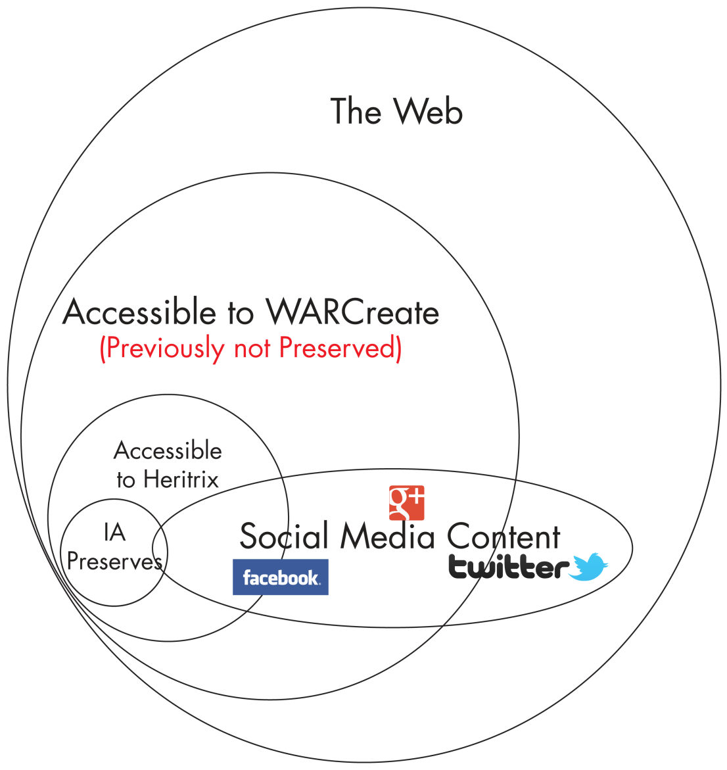
Extent of the Unpreserved
Notes:
Internet Archive (IA) captured only public web
Crawlers miss content behind authentication
Quantity of content behind auth > public web
∴ Large amount of content is not preserved

Slide 9
Ways to Capture Missing Content: Supply crawler with auth credentials
Unsuitable for institutional crawlers
Other Personal Web Archiving problems remain

Slide 10
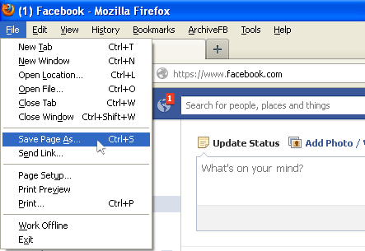
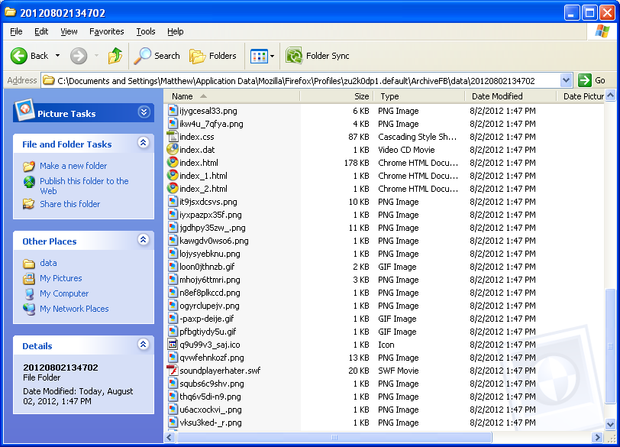
Ways to Capture Missing Content: “Save As” Desired Pages
Miss metadata
Doesn’t produce interoperable output

Slide 11
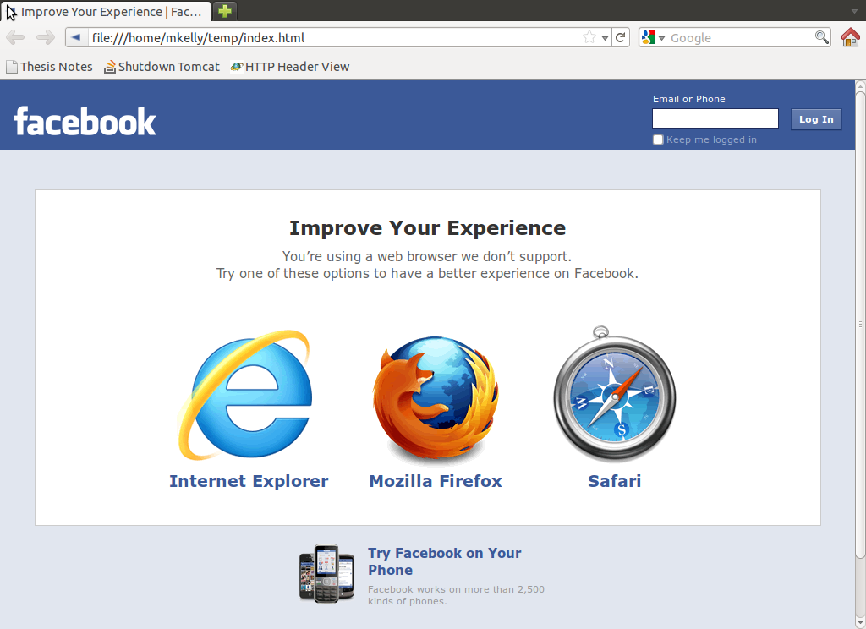
Ways to Capture Missing Content: Utilize Fetching Tools
Lose look & feel
Difficult capturing all content desired
Frequently sub- optimal output format

Slide 12

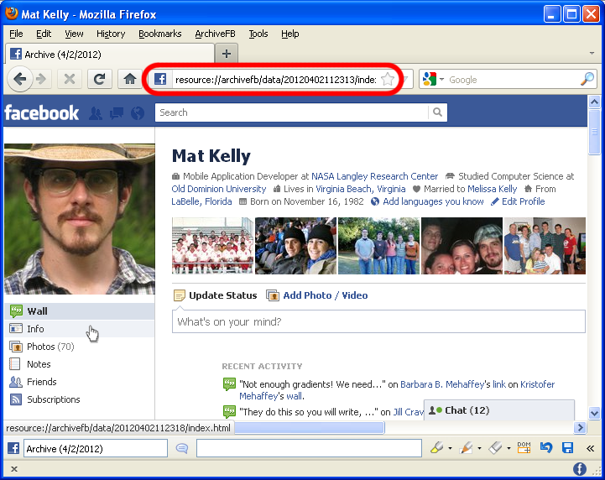

Tools Utilized In Thesis: Archive Facebook
Firefox add-on
Creates navigable “web archives”
Outputs files w/ original file type
Sequential Archiving

Slide 13

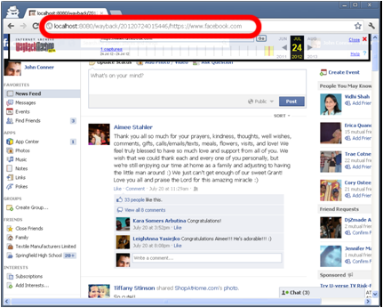
Tools Utilized In Thesis: WARCreate
Google Chrome extension
Creates Wayback- Compatible Web ARChive (WARC) files
Allows page manipulation prior to generating archive

Slide 15



Integration with Other Tools
Wayback (WARC replay system)
Allows WARCreate output to be re-experienced
Provides content for Memento
Memento
Allows temporal traversal of archived pages
Timegate serves as relay only to local wayback instance
XAMPP (Client-Side Server Suite)
Overcome Javascript inadequacies
Provide foundation for replay system

Slide 16

Institutional vs. Personal Web Archiving

Slide 17
Institutional vs. Personal Web Archiving

Slide 18
Institutional vs. Personal Web Archiving
Crawls
WWW

Slide 19

Institutional vs. Personal Web Archiving
Crawls
WWW

Slide 20
Institutional vs. Personal Web Archiving
Crawls
WWW
outputs
WARC

Slide 21

Institutional vs. Personal Web Archiving
Crawls
WWW
outputs
WARC

Slide 22
Institutional vs. Personal Web Archiving
Crawls
WWW
outputs
WARC
Indexes

Slide 23
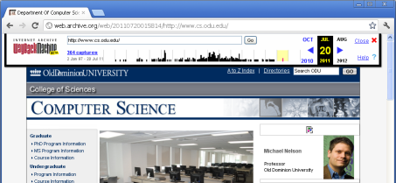

Institutional vs. Personal Web Archiving
Crawls
WWW
outputs
WARC
Publicly viewable
Archive replay
Indexes

Slide 24
Institutional vs. Personal Web Archiving

Slide 25

Institutional vs. Personal Web Archiving

Slide 26
Institutional vs. Personal Web Archiving

Slide 27
Institutional vs. Personal Web Archiving
WARC

Slide 28

Institutional vs. Personal Web Archiving
WARC

Slide 29
Institutional vs. Personal Web Archiving
WARC
Indexes

Slide 30
Institutional vs. Personal Web Archiving
WARC
Indexes

Slide 32
Problems Specific to Personal Web Archiving
Personalization/Authentication
Different users, facebook.com, different content
Context
Different browsing tools, different site experience
Output Format
Ad hoc approaches are often used that lose metadata, context, content, etc.

Slide 33
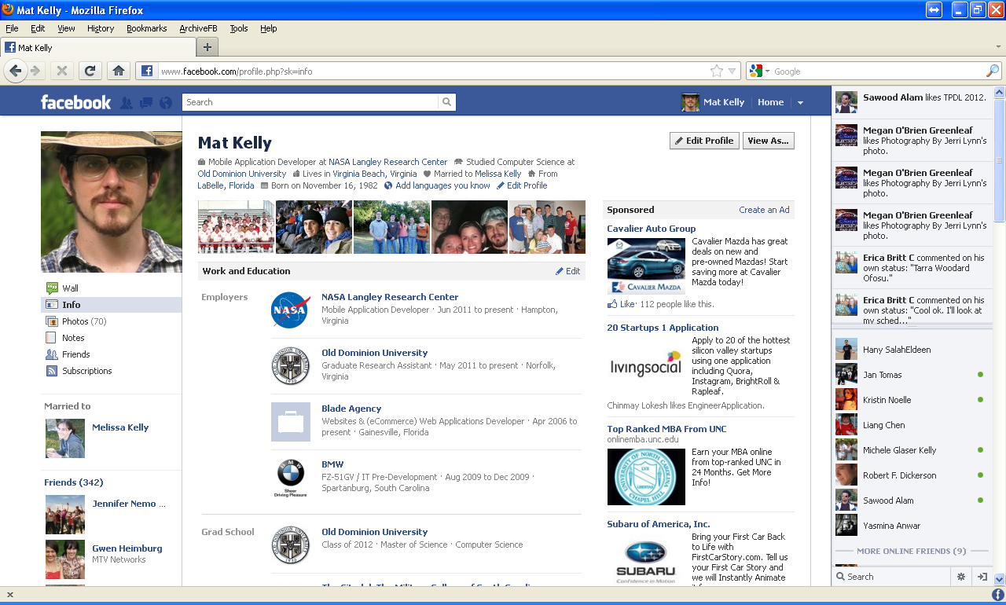
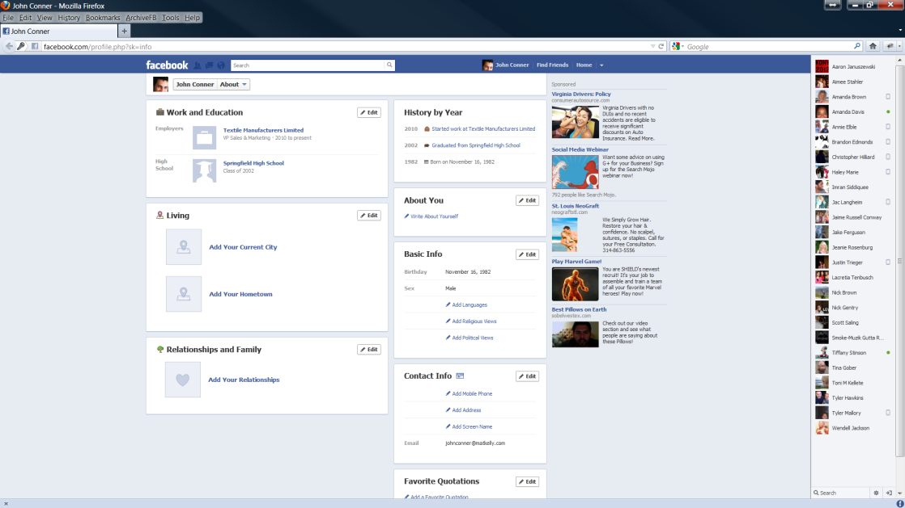
Personalization/Authentication
Two users, same URI, vastly different content
One user, same URI, authentication vs. no authentication, different content
As shown in IA’s archive of FB

Slide 34
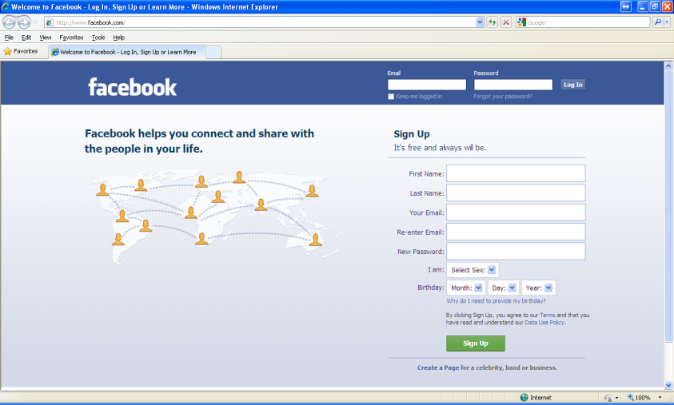
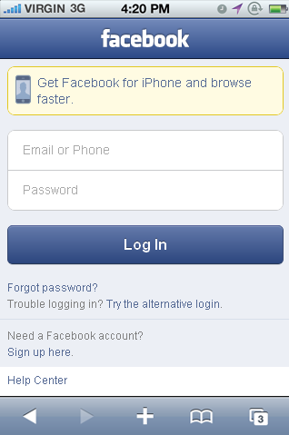
Context
Same URI+diff devices = diff content served
Mobile vs. PC
Firefox vs. Chrome
<!--[if lt IE 5]>
Your browser is too old and cannot render this content.
<![endif]-->
<!--[if gte IE 9]>
...features not supported by version of IE prior to 9...
<![endif]-->

Slide 35
Output Format
Notes:
Shows result from AFB / save webpage as
Files chaotically named

Slide 36
Output Format
Saving only HTML is not enough
Local references need manipulation
Browser alone is insufficient replay system

Slide 37
Output Format
Misses HTTP headers
Request & Response
e.g., Auth
If headers included, inputs for personalization can be viewed
REQUEST
GET / HTTP/1.1 Host: www.facebook.com User-Agent: Mozilla/5.0 (Windows NT 5.1; rv:14.0) Gecko/20100101 Firefox/14.0.1 Accept: text/html,application/xhtml+xml,application/xml;q=0.9,*/*;q=0.8 Accept-Language: en-us,en;q=0.5 Accept-Encoding: gzip, deflate Connection: keep-alive Cookie: datr=KMo6T3jicPEdEl4pY2yFnr6F; lu=TgU4dhoSBG0ZmEnThtLeyqIA; c_user=100003509861423; fr=0KMqEWNPPgver2SIx.AWXf-6Ww_7iQFPPP9sFtiiMPaV0; s=Aa4dL41H8UGZ-4Lf.BQGryl; xs=1%3Am7APtmN9-ev4Vg%3A0%3A1343929509; act=1343929622029%2F3%3A2; p=1; presence=EM343929627EuserFA21B03509861423A2EstateFDsb2F0Et2F_5b_5dElm2FnullEuct2F1343929017BEtrFnullEtwF3302582290EatF1343929627063EutF0EsndF1EnotF0CEchFDp_5f1B03509861423F1CC
NOT CAPTURED BY BACKUP TOOLS/METHODS
RESPONSE
HTTP/1.1 200 OK Cache-Control: private, no-cache, no-store, must-revalidate Expires: Sat, 01 Jan 2000 00:00:00 GMT P3P: CP="Facebook does not have a P3P policy. Learn why here: http://fb.me/p3p" Pragma: no-cache X-Content-Type-Options: nosniff x-frame-options: DENY X-XSS-Protection: 1; mode=block Content-Encoding: gzip Content-Type: text/html; charset=utf-8 X-FB-Debug: uMXm8343NOn0OOIeDna2teVECApUiEqj6s7GTwNx+Ss= Date: Thu, 02 Aug 2012 19:26:12 GMT Transfer-Encoding: chunked Connection: keep-alive
Notes:
State of resource subject to inputs
Browser sends but usually hides headers, not caught on capture by AFB
REQUEST headers are important, allow overcome context/personalization issues

Slide 38
Specification and OOP
Sites’ hierarchies resemble OOP concepts (polymorphism, inheritance)
Sites’ sections can be represented as classes
Classes converted to XML specification
Personal Web Archiving tools utilize this specification to become adaptive

Slide 39



Commonality of “Sections” Between Social Media Websites
Abstracted media type
personal stream | wall | posts | my tweets
global stream | news feed | streams | followees’ tweets
multimedia - photos | photos | photos
multimedia - videos | videos | videos
photo collection | albums
posts | notes
friends | friends | circles

Slide 40
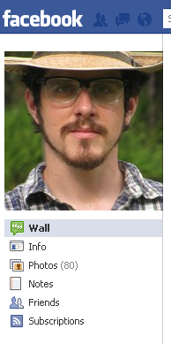
Example: Facebook Section Objects
SocialMediaWebsite facebook = new SocialMediaWebsite(homepage => "http://www.facebook.com")
facebook->decorate([
new SocialMediaWebsiteSectionPersonalStream(
name => "Wall",
url => "http://www.facebook.com/profile.php?sk=wall",
preprocessor => new SocialMediaScrollPrepreprocessor(
timeBetweenFirings => 0,
maxFirings = 0,
conditionBeforeSubsequentFirings = null
)
),
new SocialMediaWebsiteSectionUserInfo(
name => "Info",
url => "http://www.facebook.com/profile.php?sk=info"
),
new SocialMediaWebsiteSectionMultimediaCollection(
name => "Photos",
url => "http://www.facebook.com/profile.php?sk=photos",
proprocessor => new SocialMediaScrollPreprocessor(
timeBetweenFirings => 0,
maxFirings => 0,
conditionBeforeSubsequentFirings = null
)
),
...

Slide 41
Example: Facebook Section Objects
SocialMediaWebsite facebook = new SocialMediaWebsite(homepage => "http://www.facebook.com")
facebook->decorate([
new SocialMediaWebsiteSectionPersonalStream(
name => "Wall",
url => "http://www.facebook.com/profile.php?sk=wall",
preprocessor => new SocialMediaScrollPrepreprocessor(
timeBetweenFirings => 0,
maxFirings = 0,
conditionBeforeSubsequentFirings = null
)
),
new SocialMediaWebsiteSectionUserInfo(
name => "Info",
url => "http://www.facebook.com/profile.php?sk=info"
),
new SocialMediaWebsiteSectionMultimediaCollection(
name => "Photos",
url => "http://www.facebook.com/profile.php?sk=photos",
proprocessor => new SocialMediaScrollPreprocessor(
timeBetweenFirings => 0,
maxFirings => 0,
conditionBeforeSubsequentFirings = null
)
),
...

Slide 42
Example: Facebook Section Objects
SocialMediaWebsite facebook = new SocialMediaWebsite(homepage => "http://www.facebook.com")
facebook->decorate([
new SocialMediaWebsiteSectionPersonalStream(
name => "Wall",
url => "http://www.facebook.com/profile.php?sk=wall",
preprocessor => new SocialMediaScrollPrepreprocessor(
timeBetweenFirings => 0,
maxFirings = 0,
conditionBeforeSubsequentFirings = null
)
),
new SocialMediaWebsiteSectionUserInfo(
name => "Info",
url => "http://www.facebook.com/profile.php?sk=info"
),
new SocialMediaWebsiteSectionMultimediaCollection(
name => "Photos",
url => "http://www.facebook.com/profile.php?sk=photos",
proprocessor => new SocialMediaScrollPreprocessor(
timeBetweenFirings => 0,
maxFirings => 0,
conditionBeforeSubsequentFirings = null
)
),
...

Slide 43
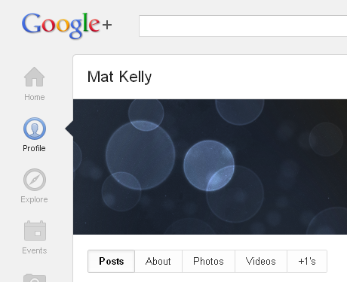
Example: Hierarchical Similarities
SocialMediaWebsite facebook = new SocialMediaWebsite(homepage => "http://www.facebook.com")
facebook->decorate([
new SocialMediaWebsiteSectionPersonalStream(
name => "Wall",
url => "http://www.facebook.com/profile.php?sk=wall",
preprocessor => new SocialMediaScrollPrepreprocessor(
timeBetweenFirings => 0,
maxFirings = 0,
conditionBeforeSubsequentFirings = null
)
),
new SocialMediaWebsiteSectionUserInfo(
name => "Info",
url => "http://www.facebook.com/profile.php?sk=info"
),
new SocialMediaWebsiteSectionMultimediaCollection(
name => "Photos",
url => "http://www.facebook.com/profile.php?sk=photos",
proprocessor => new SocialMediaScrollPreprocessor(
timeBetweenFirings => 0,
maxFirings => 0,
conditionBeforeSubsequentFirings = null
)
),
...

Slide 44
Spec Retrieval Process
Tool accesses root spec w/ URI parameter
Spec returns with reference to site- specific hierarchy spec
Tool fetches site spec
Updated site hierarchy returned
Root Spec
Site Spec
(spec)/facebook.xml

Slide 45
Concrete Usage – Tool Adaptation
Archive Facebook
Map current URIs to remotely fetched URIs
Perform pre-processing defined in FB spec
WARCreate
Implement sequential/cohesive archiving

Slide 46
Evaluation 1:Tool Adaptability
Setup synthetic social media website
Define site’s remote spec
Change AFB to preserve synthetic site
Change hierarchy of synthetic site
Show AFB breaking
Change synthetic site spec
Show AFB functionality restored

Slide 47
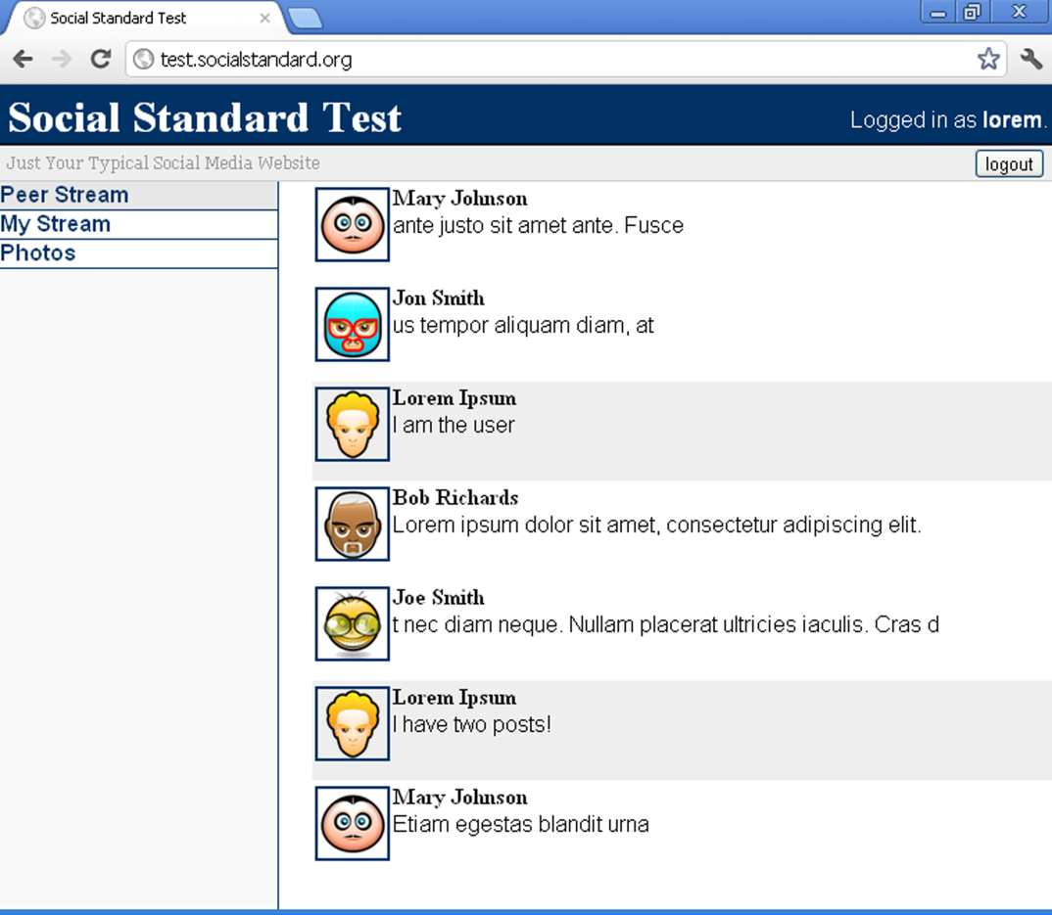
Evaluation 1: Tool Adaptability Step 1: Synthetic Site Creation
Simple hierarchy for base case testing
Requires Auth
Utilizes CDN
Can be manipulated
Recursive Sections

Slide 48
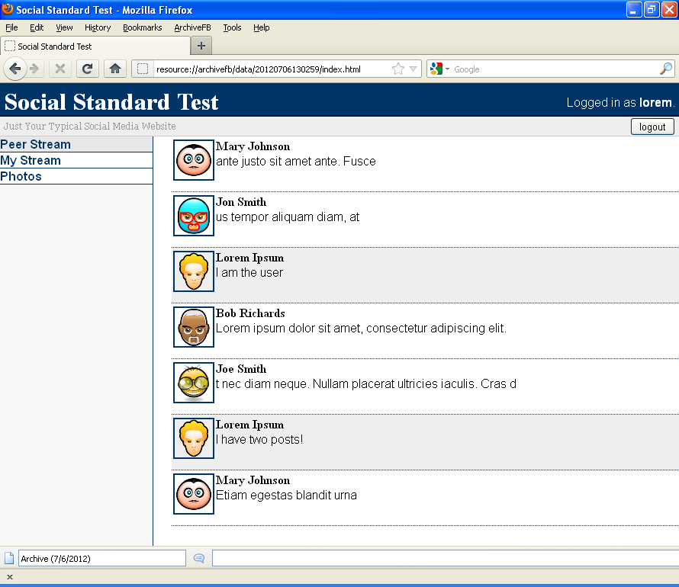
Evaluation 1: Tool Adaptability Step 2: Define Site Remove Spec
<?xml version="1.0" ?>
<socialMediaWebsite>
<homepage>http://test.socialstandard.org</homepage>
<sections>
<socialMediaWebsiteSection type="SocialMediaWebsiteSectionPersonalStream">
<name>Personal Stream</name>
<url>http://test.socialstandard.org/personal</url>
<preprocessor type="SocialMediaScrollPreprocessor">
<timeBetweenFirings>0</timeBetweenFirings>
<maxFirings>0</maxFirings>
<conditionBeforeSubsequentFiring>?</conditionBeforeSubsequentFiring>
</preprocessor>
</socialMediaWebsiteSection>
<socialMediaWebsiteSection type="SocialMediaWebsiteSectionMultimediaCollection">
<name>Photo Albums</name>
<url>http://test.socialstandard.org/albums</url>
<preprocessor type="SocialMediaScrollPreprocessor">
<timeBetweenFirings>0</timeBetweenFirings>
<maxFirings>0</maxFirings>
<conditionBeforeSubsequentFiring>?</conditionBeforeSubsequentFiring>
</preprocessor>
<children>
<regex>&lt;div class=\"album.*&lt;a\shref=\"(.*)\"</regex>
<type>SocialMediaWebsiteSectionMultimediaCollection</type>
<name>Photo Album</name>
</children>
</socialMediaWebsiteSection>
<socialMediaWebsiteSection type="SocialMediaWebsiteSectionMultimediaCollection">
<name>Photo Album</name>
<url>http://test.socialstandard.org/album/[a-zA-Z0-9]+</url>
<preprocessor type="SocialMediaScrollPreprocessor">
<timeBetweenFirings>0</timeBetweenFirings>
<maxFirings>0</maxFirings>
<conditionBeforeSubsequentFiring>?</conditionBeforeSubsequentFiring>
</preprocessor>
<children>
<regex>&lt;div class=\"album.*&lt;a\shref=\"(album/[a-zA-Z0-9]+)\"</regex>
<type>SocialMediaWebsiteSectionMultimediaCollection</type>
<name>Photo</name>
</children>
</socialMediaWebsiteSection>
<socialMediaWebsiteSection type="SocialMediaWebsiteSectionMultimediaPhoto">
<name>Photo</name>
<url>http://test.socialstandard.org/album/[a-zA-Z0-9]+/photo/[a-zA-Z0-9]+</url>
</socialMediaWebsiteSection>
<socialMediaWebsiteSection type="SocialMediaWebsiteSectionPeerStream">
<name>Peer Stream</name>
<url>http://test.socialstandard.org/</url>
<preprocessor type="SocialMediaScrollPreprocessor">
<timeBetweenFirings>0</timeBetweenFirings>
<maxFirings>0</maxFirings>
<conditionBeforeSubsequentFiring>?</conditionBeforeSubsequentFiring>
</preprocessor>
</socialMediaWebsiteSection>
</sections>
</socialMediaWebsite>

Slide 49
Evaluation 1: Tool Adaptability Step 3: Change AFB to preserve synthetic site
getCurrentSiteSpec : function(step,urlIn,hostIn){
switch(step){
case 0:
var xhr = new XMLHttpRequest();
var siteSpec = "", uriOut = "";
$.ajax({
url: urlIn,
success: function(data){
var host = "www.facebook.com"; //hostIn n/a here
var parser = new DOMParser();
var socialMediaWebsites = $(data.childNodes[0]).children();
for(var i=0; i<socialMediaWebsites.length; i++){
var smw = socialMediaWebsites[i];
if($(smw).find("homepage").text().indexOf(host) != -1){
siteSpec = $(smw).find("specification").text();
getCurrentSiteSpec(1,siteSpec,host);
} //fi
} //rof
}, error: function(){}
}); //xaja
break;
case 1:
$.ajax({
url: urlIn,
success: function(data){
var ls = window.content.localStorage;
ls.setItem("spec", (new XMLSerializer()).serializeToString(data));
archivefbBrowserOverlay.capture(ls.getItem("spec"));
}, error : function(){}
};
break;
}
}
Utilize existing capture mechanisms
Exploit guaranteed attributes (e.g., host)
Make code general enough to be widely applicable to sections

Slide 50
Evaluation 1: Tool Adaptability Step 4: Change hierarchy of synthetic site
Simulate simply through mod_rewrite
Previously:
Updated:
Disavow previous reference altogether to ensure 404
RewriteRule ^personal$ index.php?section=personal [NC]
RewriteRule ^myfeed$ index.php?section=personal [NC]

Slide 51
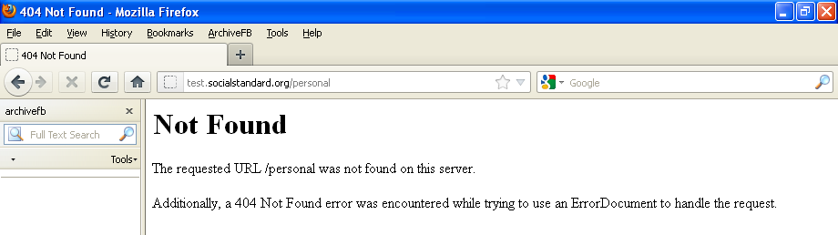
Evaluation 1: Tool Adaptability Step 5: Show AFB breaking
Run archiving procedure again, note failing of procedure or content not captured

Slide 52
Evaluation 1: Tool Adaptability Step 6: Change synthetic site spec
<?xml version="1.0" ?>
<socialMediaWebsite>
<homepage>http://test.socialstandard.org</homepage>
<sections>
<socialMediaWebsiteSection type="SocialMediaWebsiteSectionPersonalStream">
<name>Personal Stream</name>
<url>http://test.socialstandard.org/personal</url>
<preprocessor type="SocialMediaScrollPreprocessor">
<timeBetweenFirings>0</timeBetweenFirings>
<maxFirings>0</maxFirings> <conditionBeforeSubsequentFiring>?</conditionBeforeSubsequentFiring>
</preprocessor>
</socialMediaWebsiteSection>
…
<?xml version="1.0" ?>
<socialMediaWebsite>
<homepage>http://test.socialstandard.org</homepage>
<sections>
<socialMediaWebsiteSection type="SocialMediaWebsiteSectionPersonalStream">
<name>Personal Stream</name>
<url>http://test.socialstandard.org/myfeed</url>
<preprocessor type="SocialMediaScrollPreprocessor">
<timeBetweenFirings>0</timeBetweenFirings>
<maxFirings>0</maxFirings> <conditionBeforeSubsequentFiring>?</conditionBeforeSubsequentFiring>
</preprocessor>
</socialMediaWebsiteSection>
…

Slide 53
Evaluation 1: Tool Adaptability Step 7: Show AFB functionality restored
Execute archiving procedure of tool w/o modifying code
Show that result matches step 1

Slide 54

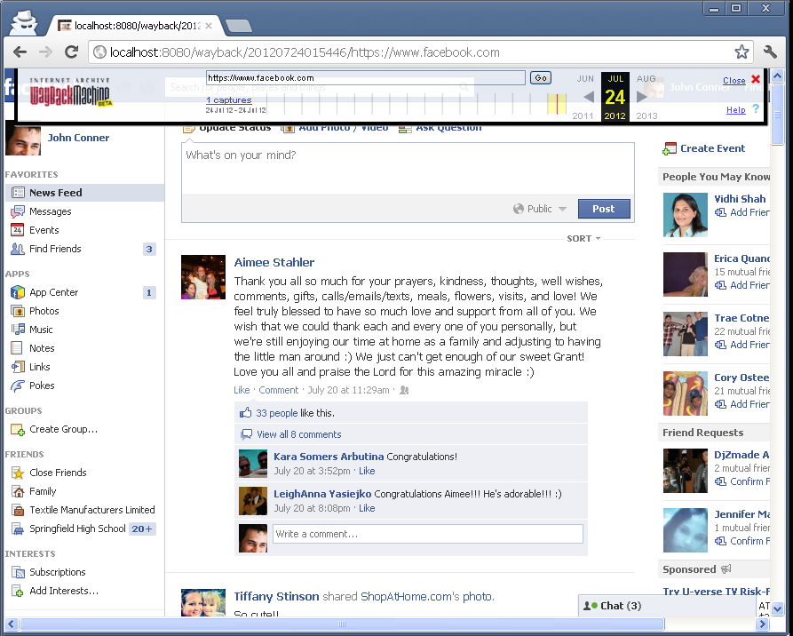
Evaluation 2: Preservation of Content Behind Authentication
Create tool (WARCreate) to store to WARC format
Setup easy-to-use Replay system (local wayback)
Execute Tool’s Archiving Procedure
Verify replayability in wayback

Slide 55
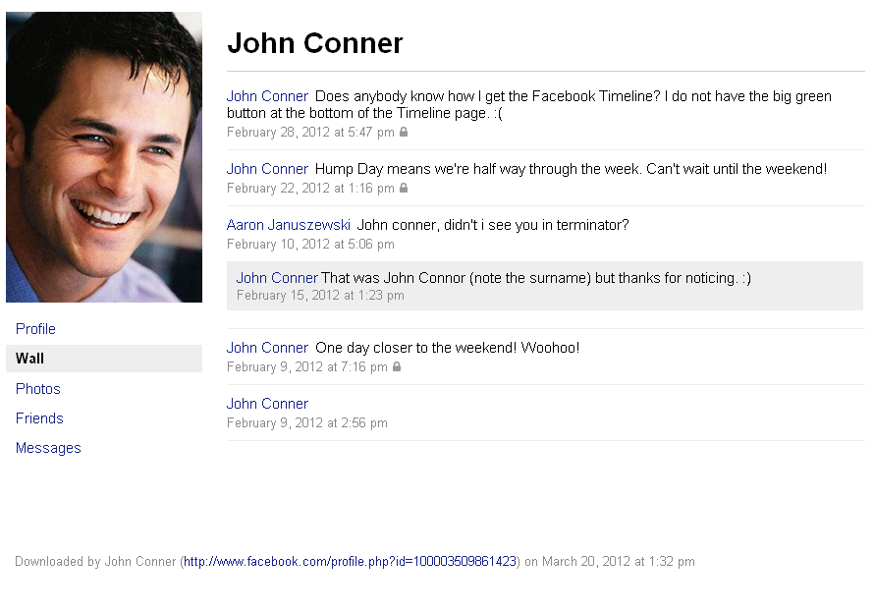
Existing Tools’ Shortcoming: Facebook Data Dump
Lose look & feel
FB decides what is preserved
Unreliable (requests not always answered)

Slide 56
Existing Tools’ Shortcoming: “Save Webpage As”
Metadata is Lost
Archive is not Self-Contained
Archive is not interoperable with Archive Replay Systems (e.g. wayback)

Slide 57
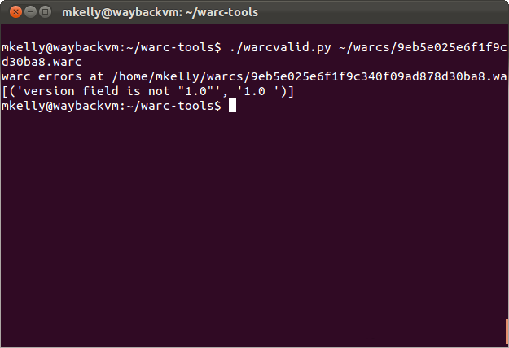
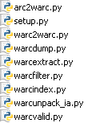
Existing Tools’ Shortcoming: warc-tools
No archive creation facility
Relies on incomplete WARC spec (like WARCreate)
Only command-line access: suitable for sysadmins and power users
Notes:
Quick to fail, note whitespace issues

Slide 58
Existing Tools’ Shortcoming: wget &wget-warc
No content manipulation
Require CLI interaction
Issue for Ajax driven content (no JS support)
wget-warc
Ext. of wget w/ WARC I/O
No look & feel preservation

Slide 59
Existing Tools’ Shortcoming: Archive Facebook
Output is not compatible w/ Wayback
Prone to breaking when FB hierarchy changed
Limited to Firefox web browser
Cannot escape browser sandbox for portable archives

Slide 60
Existing Tools’ Shortcoming: WARCreate
No built-in sequential archiving
Relies on subset of WARC spec
Limited to Chrome

Slide 61
Shortcoming of Spec
Relies on accessible URIs of sites’ sections
If base page content does not have a URI mapping, no reference exists to direct the browser
Not comprehensive of Social Media sites
Likely doesn’t account for some section types

Slide 62
Future Work
Expand spec website coverage
Account for sites w/o clearly accessible URIs
WARCreate to implement whole official WARC standard
Other SocialMediaWebsitePreprocessor types
Address perspective issues
Personalization/Auth, context, archive vs. backup

Slide 63
Contributions
Highlight Personal Web Archiving difficulties
ways they can be addressed
Provide remote spec for PWA tools to use to be more robust to sites’ hierarchy changes
Create tool (WARCreate)
allows content behind auth to be preserved to standard format
Leverage client-side server to exec scripts in support of personal web preservation
Establish section commonality between social media websites

Slide 64
Conclusions
Personal web archiving has unique problems not exhibited in conventional web archiving
Tools become more adaptive by utilizing proposed spec
Browsers can be used as medium for preservation of personal web content
With little work, server technologies can help to ease the task of personal web archiving

Slide 65
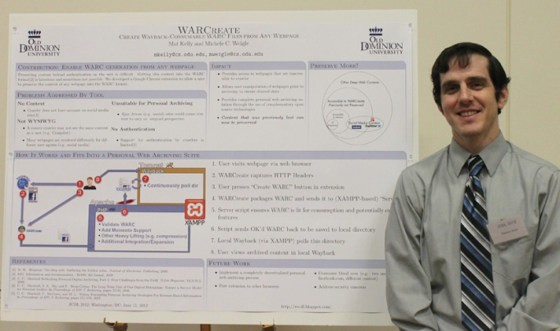
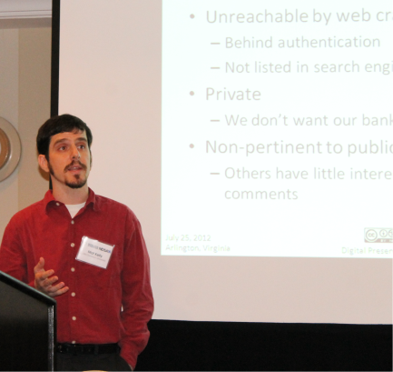
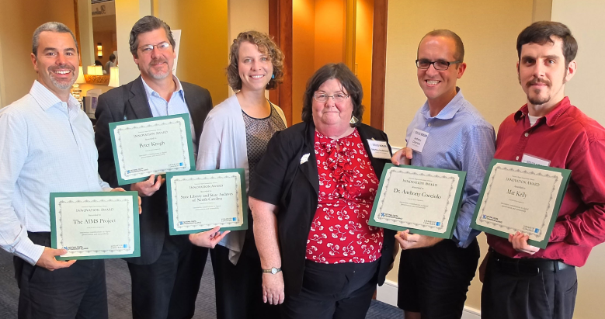
WARCreate-Related Presentations
ACM/IEEE Joint Conference on Digital Libraries
JCDL ‘12
Digital Preservation 2012
Innovation Award by NDSA/Library of Congress
For WARCreate
Mat Kelly (Old Dominion University, Norfolk, VA), Michele C. Weigle (Old Dominion University, Norfolk, VA), Michael Nelson (Old Dominion University, Norfolk, VA). "WARCreate - Create Wayback-Consumable WARC Files from Any Webpage," Digital Preservation 2012, Tools Demo Session: Web Archiving; 2012 Jul 25; Washington, DC.
Mat Kelly (Old Dominion University, Norfolk, VA) and Michele C. Weigle (Old Dominion University, Norfolk, VA), "WARCreate - Create Wayback-Consumable WARC Files from Any Webpage (demo)," In Proceedings of the ACM/IEEE Joint Conference on Digital Libraries (JCDL). Washington, DC, June 2012
For more information on:
WARCreate: http://warcreate.com
Archive Facebook: http://bit.ly/archivefb

Slide 66
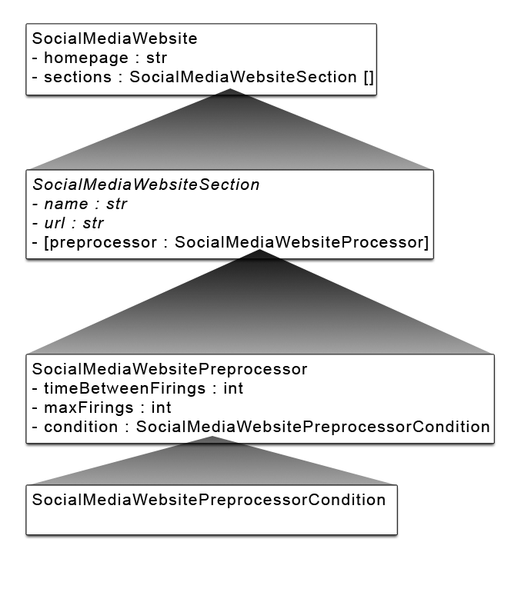
Example:Facebook Section Objects
SocialMediaWebsite facebook = new SocialMediaWebsite(homepage => "http://www.facebook.com")
facebook->decorate([
new SocialMediaWebsiteSectionPersonalStream(
name => "Wall",
url => "http://www.facebook.com/profile.php?sk=wall",
preprocessor => new SocialMediaScrollPrepreprocessor(
timeBetweenFirings => 0,
maxFirings = 0,
conditionBeforeSubsequentFirings = null
)
),
new SocialMediaWebsiteSectionUserInfo(
name => "Info",
url => "http://www.facebook.com/profile.php?sk=info"
),
new SocialMediaWebsiteSectionMultimediaCollection(
name => "Photos",
url => "http://www.facebook.com/profile.php?sk=photos",
proprocessor => new SocialMediaScrollPreprocessor(
timeBetweenFirings => 0,
maxFirings => 0,
conditionBeforeSubsequentFirings = null
)
),
...

Slide 67
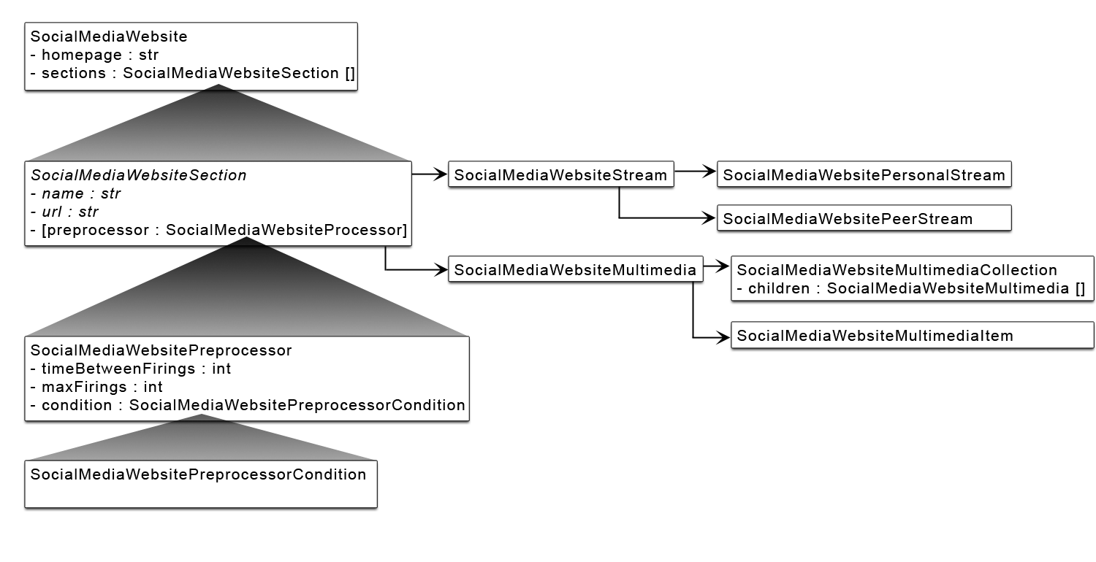
Example: Implicit Recursion

